Slide 1
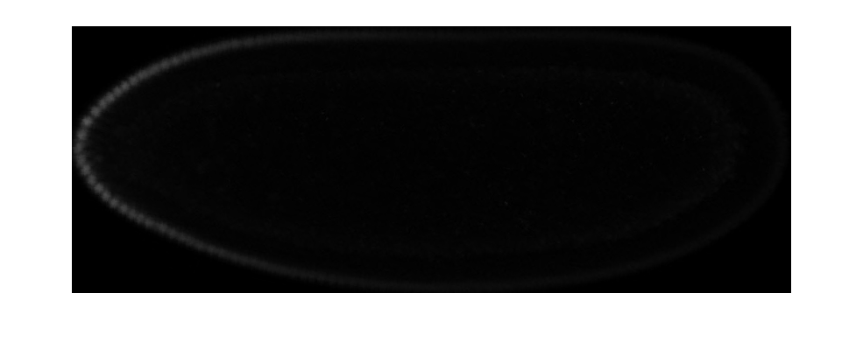
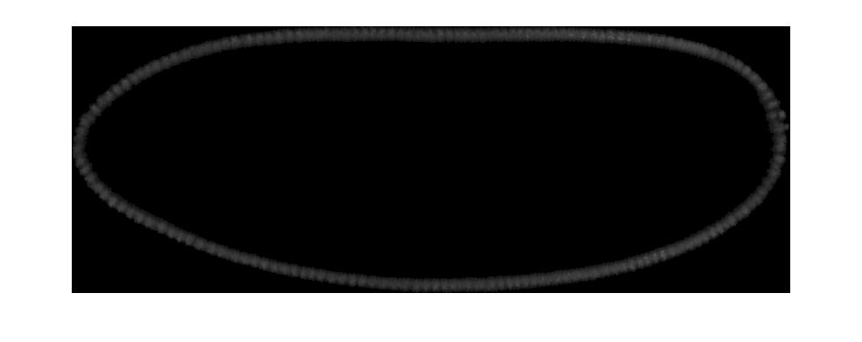
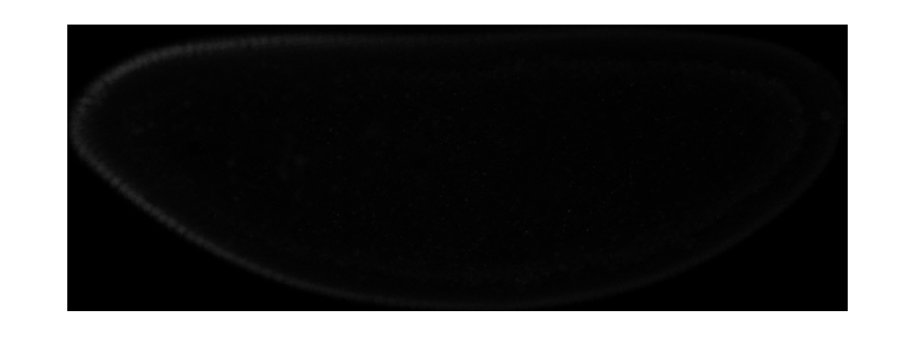
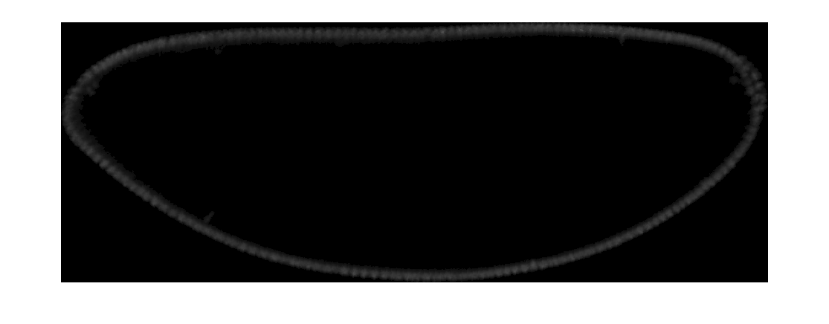
Large and Small embryos immunostained for Bicoid
Bcd protein
DAPI
Line 9.31.2
Line 2.49.3

Slide 2
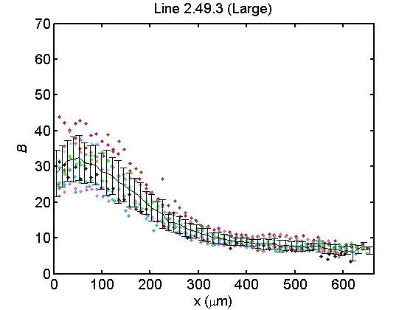
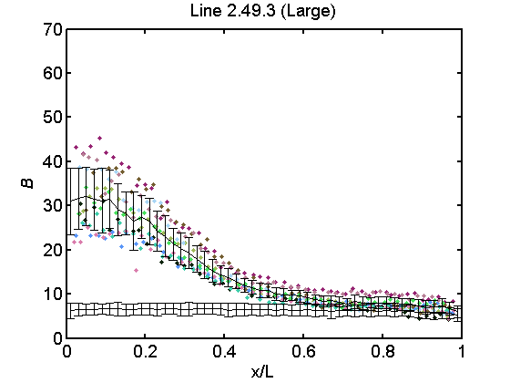
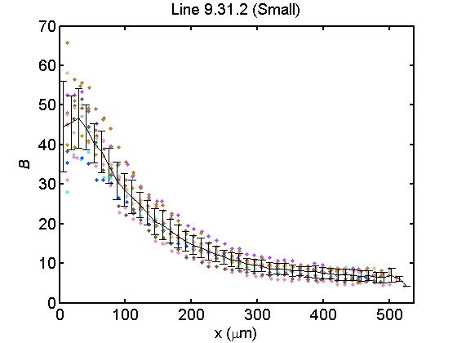
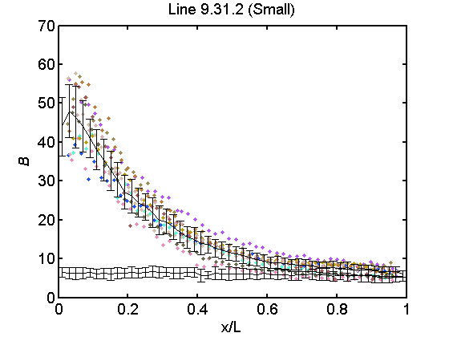
Raw Bcd Profiles

Slide 3
Mean Bicoid profiles show that there is scaling between lines
 | B0 | EL | lambda
Line 9.31.2 | 43.99 | 506.8797 | 103.26
Line 2.49.3 | 31.01 | 626.5723 | 144.4

Slide 4
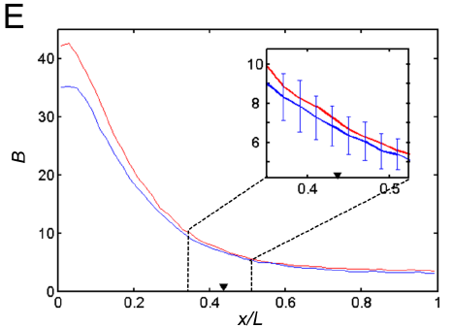
For Line 2.49.3 within-line scaling is lost
He et al. Dev Cell (2008)

Slide 5
Large embryos contain more Bcd protein
 | B
Line 2.49.3 | 513.1685
Line 9.31.2 | 499.4635

Slide 6
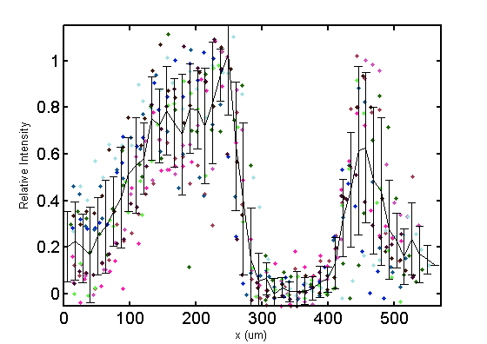
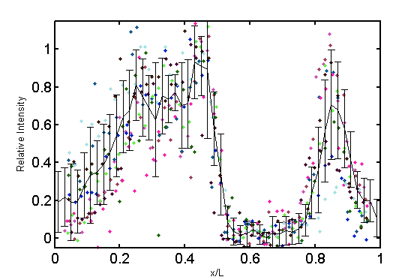
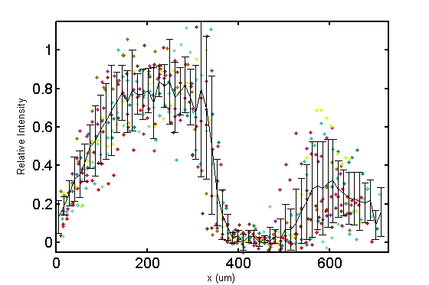
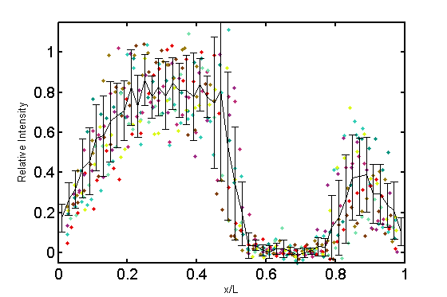
Raw Hunchback in-situ
Line 9.31.2 (Small)
Line 2.49.3 (Large)

Slide 7
Mean Hb profiles reveal scaling

Slide 8
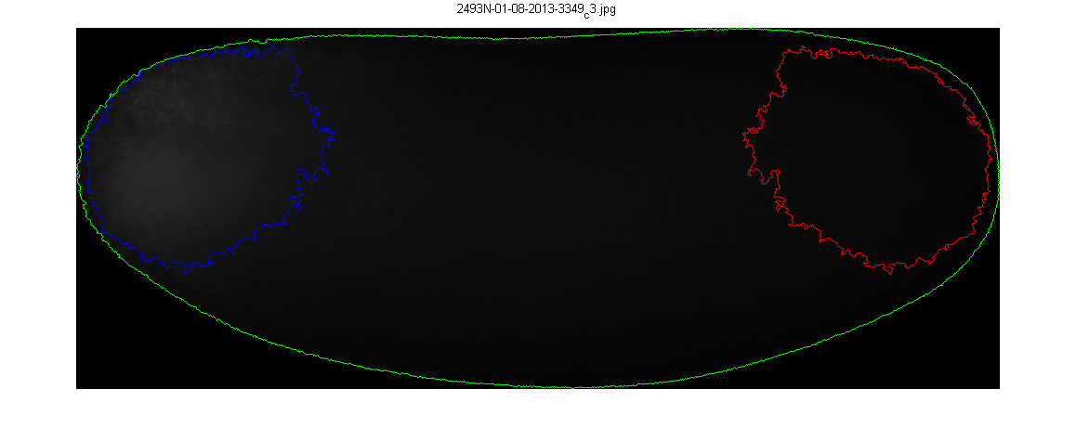
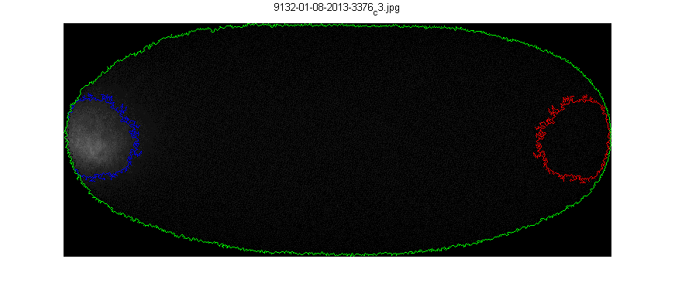
Line 2.49.3 (Large)
Line 9.31.2 (Small)
 | Egg Length (µm) | Intensity (a.u.) | Signal Area (µm²) | Egg Volume (µm³) | Embryo Area (µm²) | n
Line 2.49.3 | 666 ± 41 | 727747 ± 105254 | 26072 ± 8379 | 22141165 ± 3049121 | 315199 ± 30115 | 21
Line 9.31.2 | 498 ± 30 | 370214 ± 102166 | 8537 ± 5792 | 10518025 ± 1323310 | 188945 ± 16875 | 12
p-value | 1.51E-13 | 1.12E-10 | 3.88E-07 | 1.25E-13 | 2.28E-14

Slide 9
Bicoid mRNA intensity is correlated to embryo size

Slide 10
Bicoid mRNA signal area is correlated with embryo size

